Slide 1


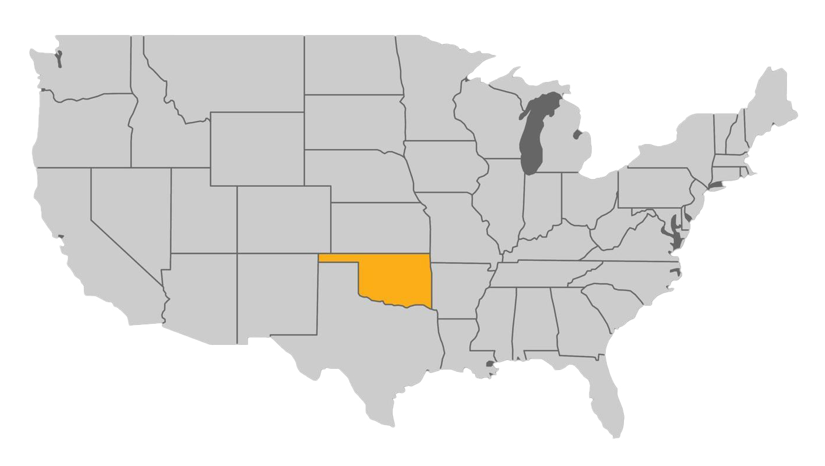

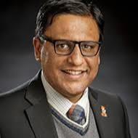

Aditya Jayadas
University: Oklahoma State University
Study program: Design & Merchandising
Years of study: 12
City: Stillwater, OK, USA
Motto for life: Live with intention, create with passion, share and smile, cherish the journey, and embrace the quiet ☺
~A Human on Mother Earth
Hobbies: Football & basketball, being in nature, watching the sky, travel, cooking & photography
Your expectations from the summer school: Share and learn from and with others ☺
Location

